Slide 1
California Housing Price Prediction Using Machine Learning
Project done individually by Alireza Mohammadshafie

Slide 2
Project Design
Goal: Develop an accurate machine learning model to predict housing prices.
Key steps planned: Data exploration, preprocessing, feature engineering, model building, evaluation, and tuning

Slide 3

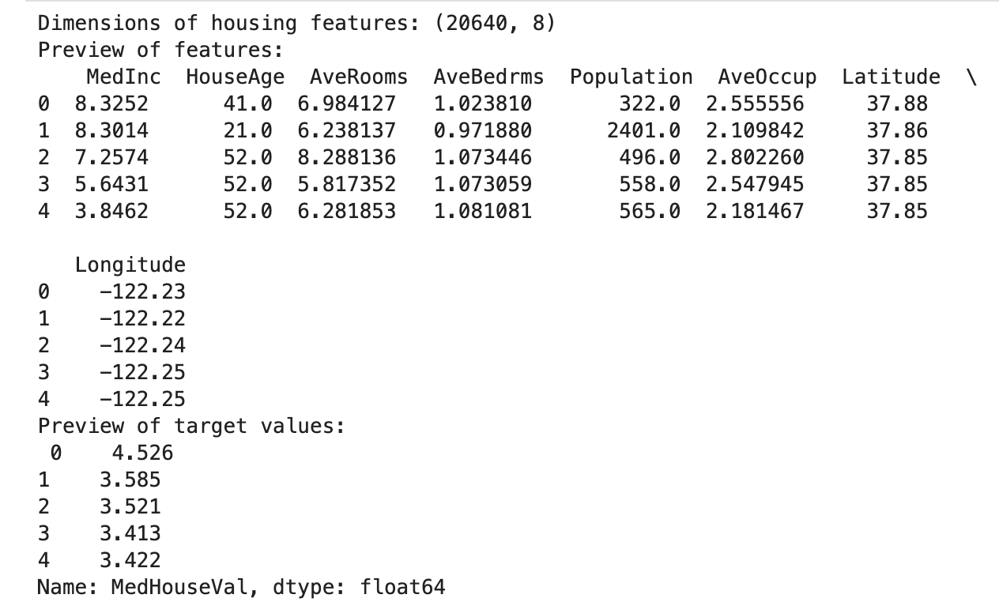
Dataset contents overview:

Slide 4
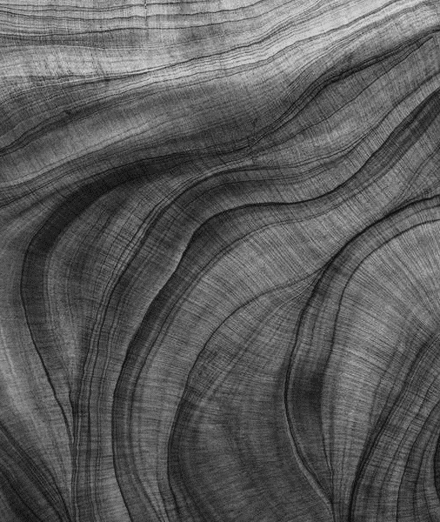
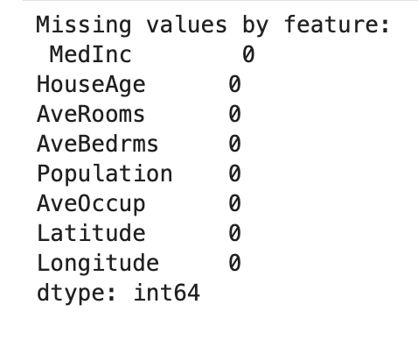
Handling missing data:

Slide 5
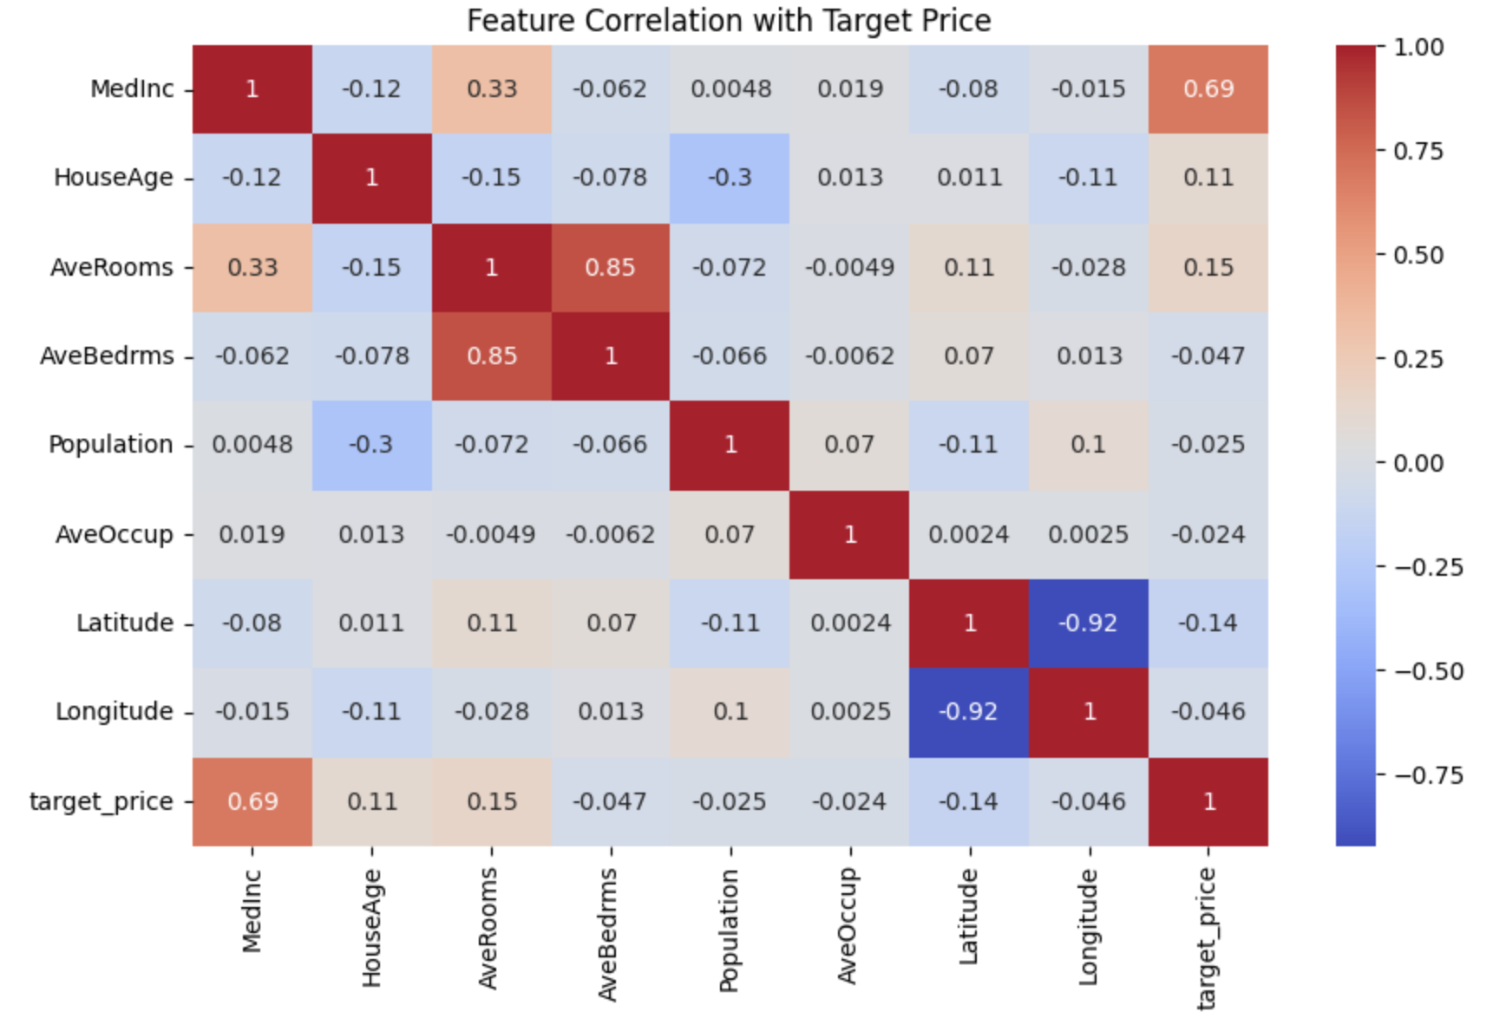
Understand feature-target relationships:

Slide 6
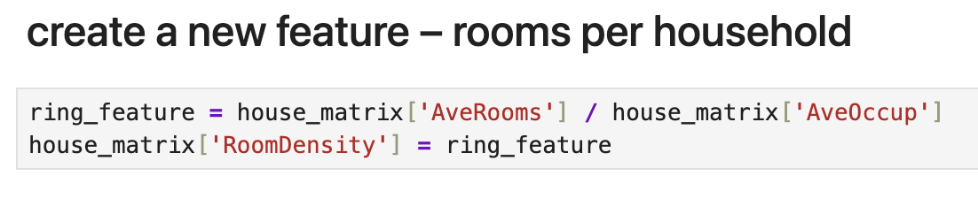
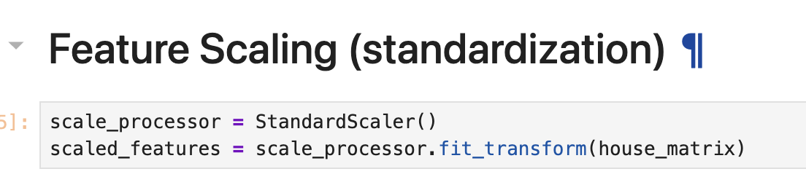
Feature Engineering:
Creation of new features from existing data

Slide 7
Model Building and Evaluation:
Train-Test Split: 80% For Training , 20% For Testing
Evaluation metrics applied:
MSE (Mean Squared Error): Average of squared differences between predicted and true values. Lower is better; penalizes large errors more.
RMSE (Root Mean Squared Error): Square root of MSE; same units as target variable. Lower is better.
MAE (Mean Absolute Error): Average of absolute differences between predicted and true values. Lower is better.
R-squared (Coefficient of Determination): Proportion of variance explained by the model. Closer to 1 means better fit; can be negative if model fits very poorly.

Slide 8
Regression models implemented :
Linear Regression
Polynomial Regression
Ridge Regression
Lasso Regression
Elastic Net Regression
Decision Tree Regression
Random Forest Regression
Gradient Boosting Regression
Support Vector Regression (SVR)
K-Nearest Neighbors Regression

Slide 9
Comparison of model performances:
Model | MSE | RMSE | MAE | R-squared
Support Vector Regression | 0.318 | 0.564 | 0.377 | 0.758
Decision Tree Regression | 0.490 | 0.700 | 0.451 | 0.626
Random Forest Regression | 0.250 | 0.500 | 0.325 | 0.809
Elastic Net | 1.043 | 1.021 | 0.805 | 0.204
Lasso Regression | 1.311 | 1.145 | 0.906 | -0.0002
Ridge Regression | 0.472 | 0.687 | 0.496 | 0.640
Gradient Boosting | 0.288 | 0.537 | 0.366 | 0.780
K-Nearest Neighbors | 0.354 | 0.595 | 0.396 | 0.730
Linear Regression | 0.472 | 0.687 | 0.496 | 0.640
Polynomial Regression | 0.398 | 0.631 | 0.440 | 0.696
Best Model

Slide 10
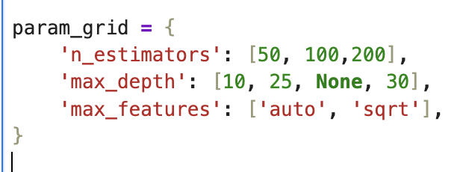
Model Tuning :
Grid search
Number of trees in the forest
The maximum depth of each tree
Number of features to consider

Slide 11

Findings and Insights:
Metric | Last Random Forest Model | New one Performance
MSE | 0.2504 | 0.2493
RMSE | 0.5004 | 0.4993
MAE | 0.3245 | 0.3283
R-squared | 0.8089 | 0.8097

Slide 12
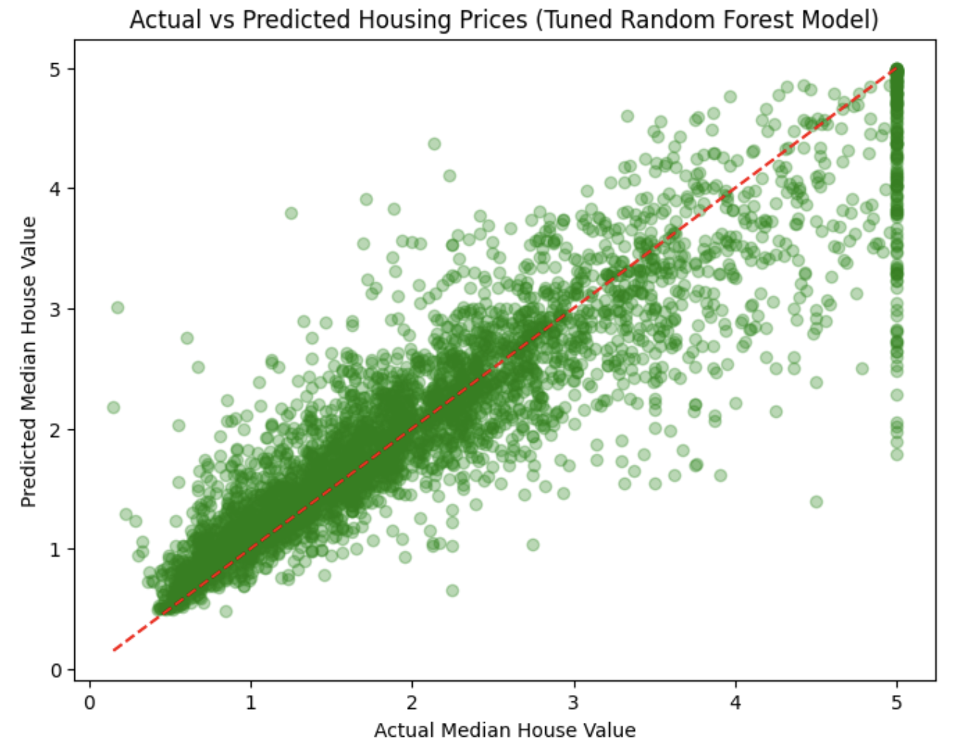
Visualizing Predictions vs True Prices :

Slide 13
Thank you

